Slide 1
Fundamentals Of Risk Management
20 May 2026

Slide 2
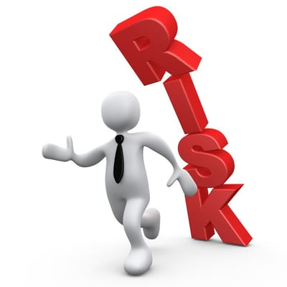
Overview of Risk Management
Risk Management is a systematic process of identifying, analyzing, evaluating, and controlling risks that may affect an organization’s objectives, project delivery, quality, cost, schedule, or compliance requirements.
Monitoring and controlling identified risks throughout the project lifecycle.
Communicating risks and mitigation plans to all relevant stakeholders and targeted audiences.

Slide 3
Objectives of Risk Management
Prevent nonconformities and project failures
Improve customer satisfaction
Ensure consistent delivery quality
Drive continual improvement
Reduce operational and business impact

Slide 4

Risk Management
Risk: “uncertainty” which if they occur will have a positive (opportunities) or negative (threats) effect on one or more objectives.
Correction: A correction is an immediate action taken to eliminate a detected issue, nonconformity, or problem.
Corrective Action: action taken to eliminate the root cause of a detected nonconformity or issue to prevent its recurrence.
Preventive Action: action taken to identify and eliminate potential causes of future nonconformities or risks before they occur.

Slide 5
Risk Management Process
Lifecycle Diagram 1.0

Slide 6
Risk Management Process
Risk Identification
The process of identifying potential risks that may affect project objectives, delivery, quality, schedule, cost, or compliance.
2. Risk Analysis
The process of analyzing identified risks to determine their likelihood, impact, severity, and possible consequences.
3. Risk Evaluation
The process of comparing analyzed risks against defined risk criteria to prioritize and decide whether the risks require treatment.
4. Risk Treatment
The process of defining and implementing actions to avoid, reduce, transfer, control, or accept identified risks based on business needs and risk severity.

Slide 7
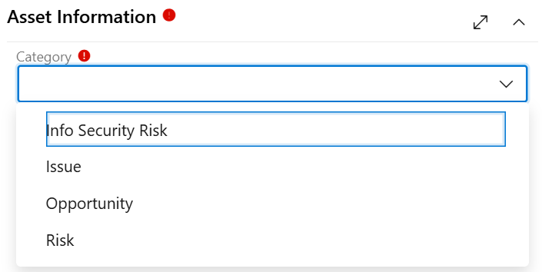
Category
Risk
Info Security Risk
Issue
Opportunity
Risk for potential project, delivery, schedule, quality, or operational risks that may occur in the future.
Info Security Risk for cybersecurity, confidentiality, integrity, or availability-related risks(ISMS).
Issue for an existing problem already impacting the project.
Opportunity for improvement or business enhancement possibilities.

Slide 8
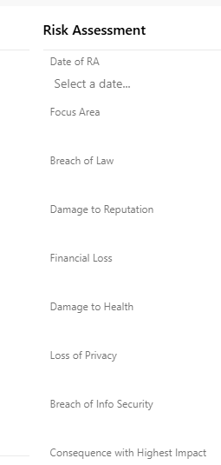
Risk Assessment
These focus areas are considered during the Risk Assessment (RA) process to evaluate potential business, legal, operational, security, and reputational impacts.
The consequence with the highest impact is determined based on the focus area or scope that carries the maximum risk value during the risk assessment process.

Slide 9
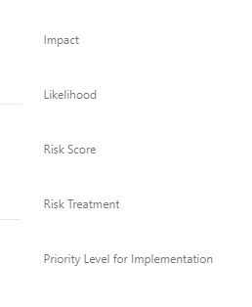
Risk Evaluation
Risk score is calculated by evaluating the likelihood of occurrence and the impact or severity of the risk.
Risk Score = Likelihood × Impact
Likelihood – Probability of the risk occurring
Impact – Severity or consequence if the risk occurs

Slide 10
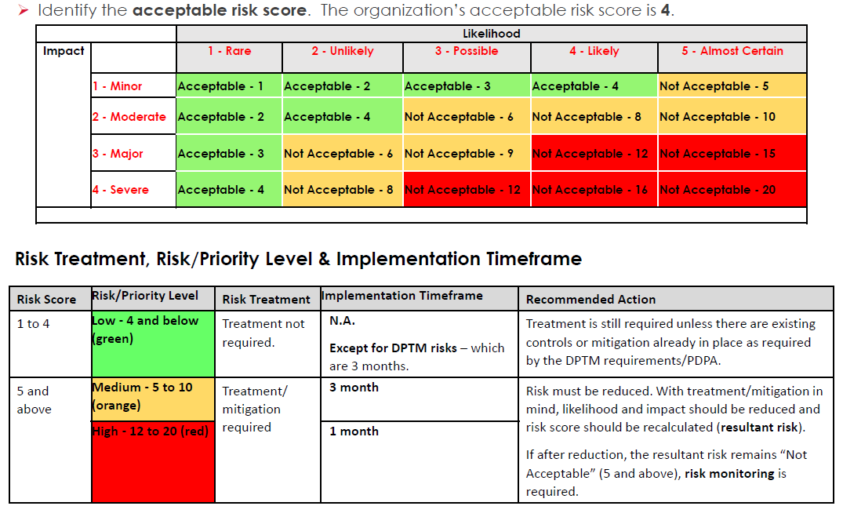
Risk Treatment

Slide 11
Best Practices While Creating Risk in ADO
Title: Clear and specific Example: “Delay in API integration due to third-party dependency”
Description: Should Include: Cause, Impact & Affected module/release
Mandatory Fields: Likelihood, Impact, Severity, Owner, & Mitigation Action Trigger Date.
Mitigation Plan: Always action-oriented
Example: “Follow up with vendor twice a week and prepare fallback API”
Traceability (Very Important for Audit): Maintain Parent-Child relationship.

Slide 12
Tips to Avoid Audit NCs
Create risks at project Initiation itself
Update risk work items regularly
Ensure every high-risk has mitigation
Maintain traceability in ADO
Conduct risk revision exercise (document evidence)
Attach proof (Sponsors approval emails, meeting notes, Security scan reports)

Slide 13
References
Create risks at project Initiation itself
Update risk work items regularly
Ensure every high-risk has mitigation
Maintain traceability in ADO
Conduct risk revision exercise (document evidence)
Attach proof (Sponsors approval emails, meeting notes, Security scan reports)

